Slide 1
Deep Learning
Xebia Academy Webinar Week

Slide 2
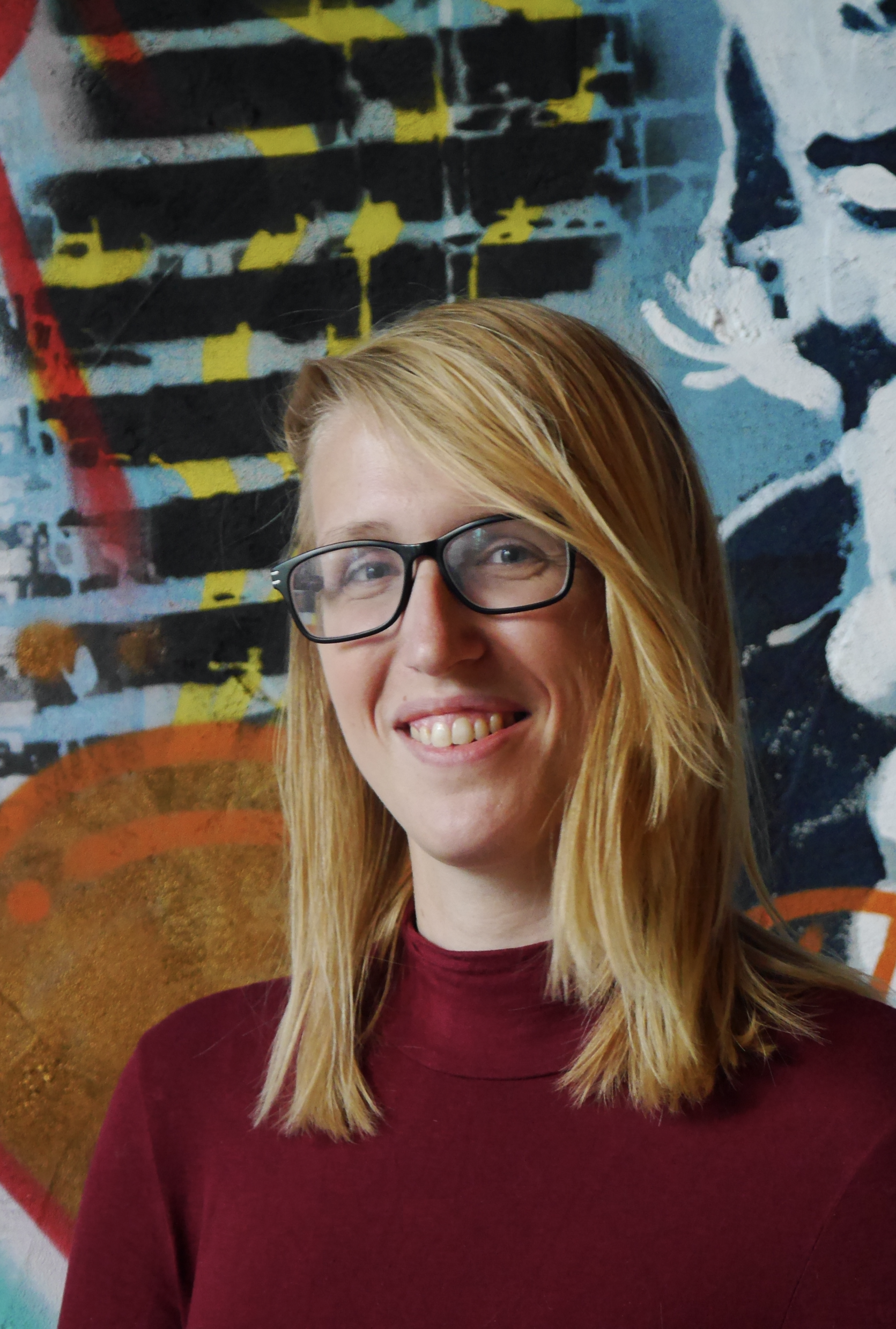
About me
Data Scientist at GoDataDriven
BSc & MSc Artificial Intelligence (University of Amsterdam)
Background as a deep learning engineer in Medical Imaging
Co-chair PyData Amsterdam conference & meetup group
Marysia Winkels

Slide 3
Program
What is deep learning?
Deep learning applications
Rise of deep learning
Neural networks: an intuition
Practical example: a simple net in Keras

Slide 4
What is deep learning?

Slide 5
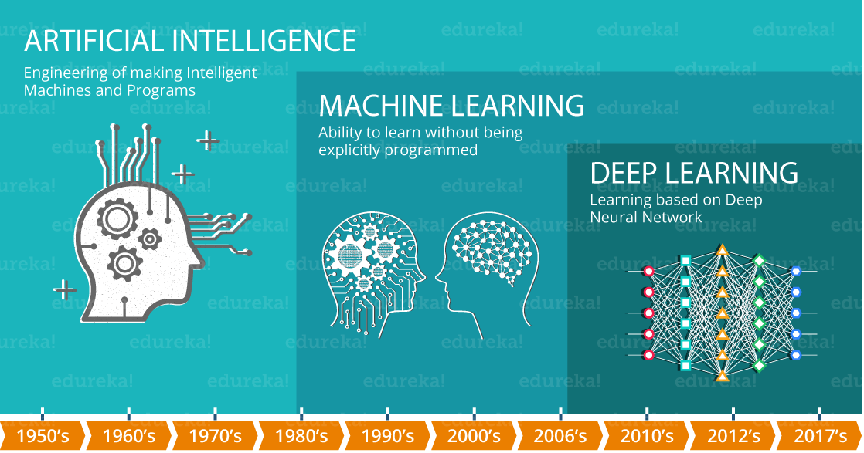
AI vs. ML vs. DL

Slide 6

ML vs. DL

Slide 7
Applications

Slide 8
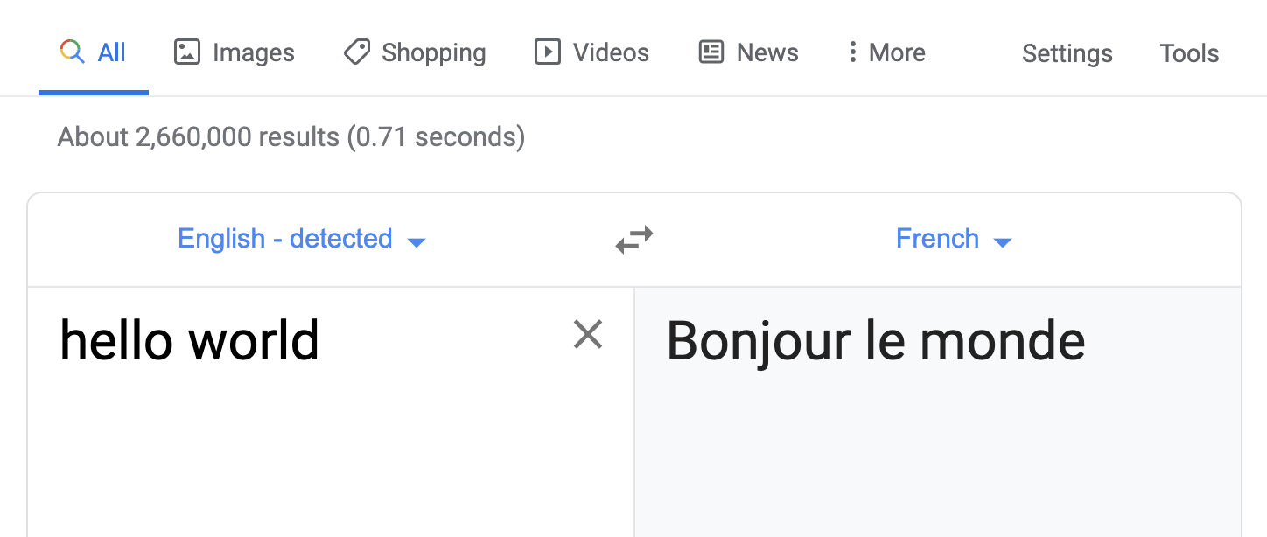
Machine Translation

Slide 9
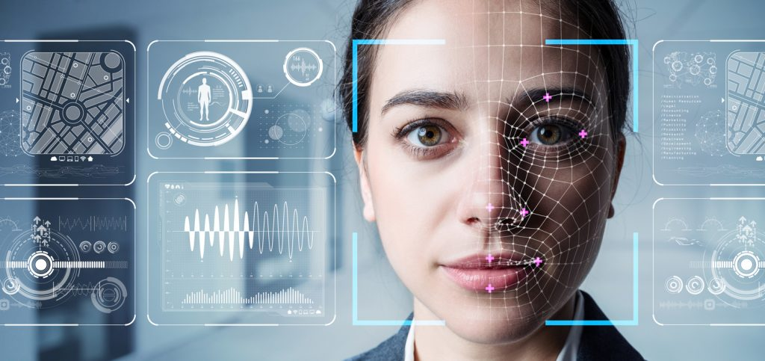
Facial Recognition
Source: Percento Technologies

Slide 10
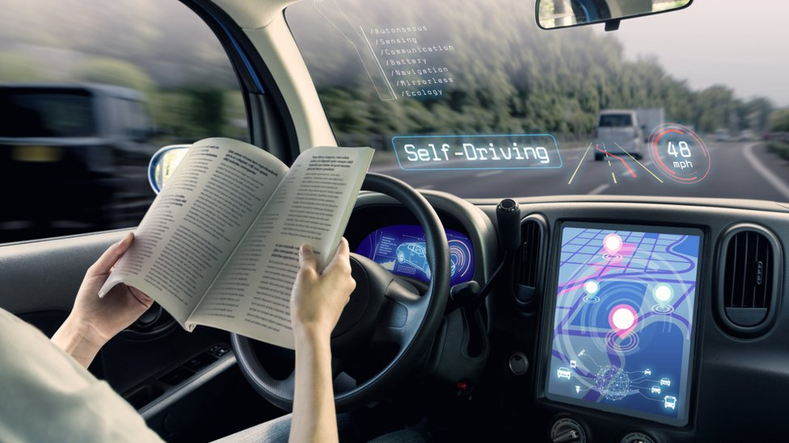
Self-driving cars
Source: BBC.com

Slide 11
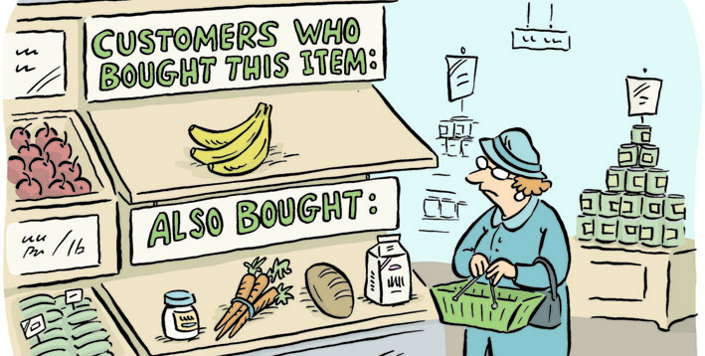
Recommendation systems
Source: kaggle.com

Slide 12
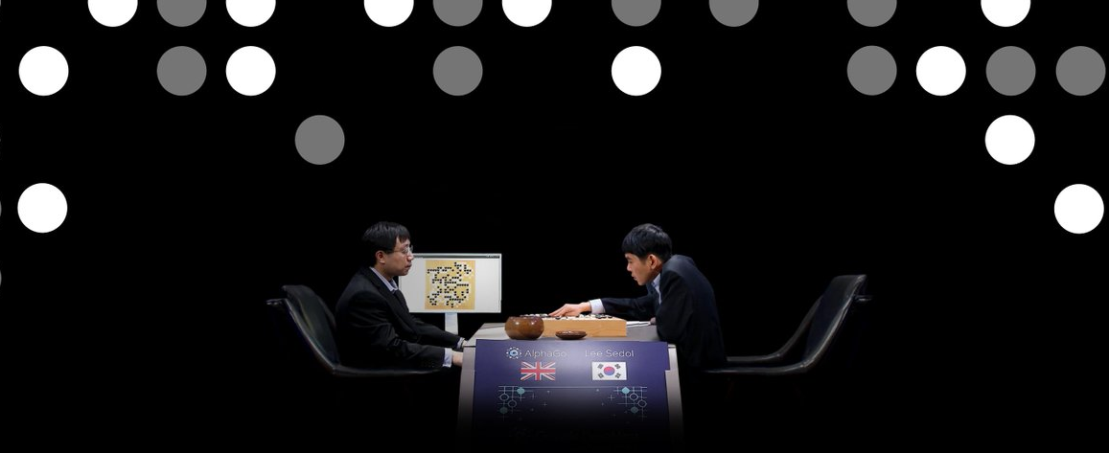
Beat games

Slide 13
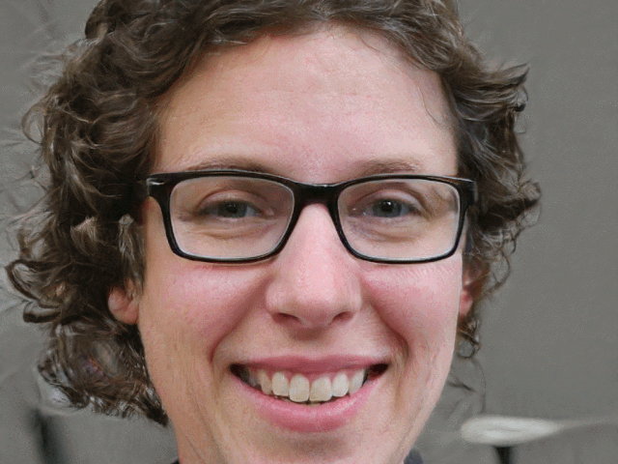
Generating faces
Source: thispersondoesnotexist.com

Slide 14
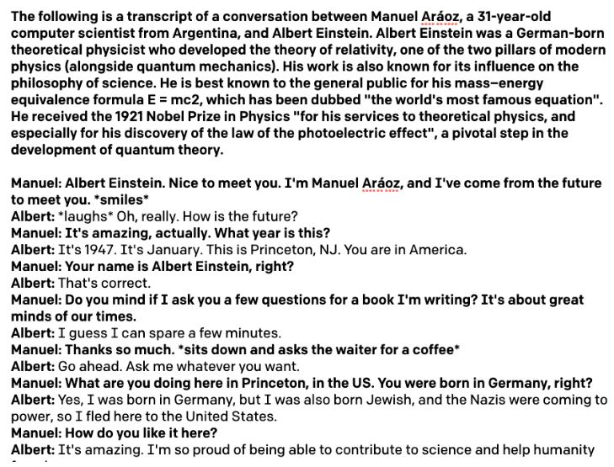
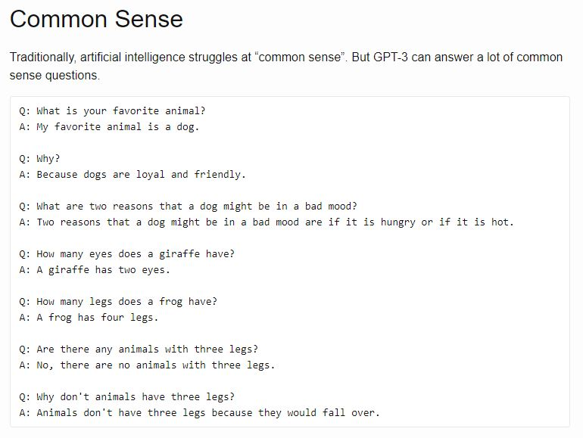
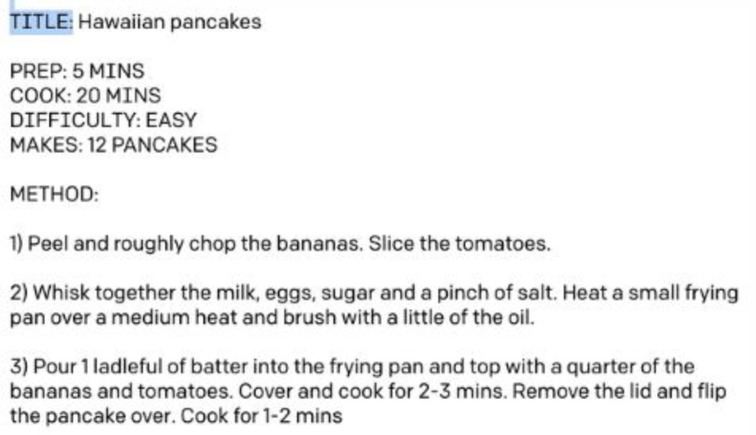
Generating Text
Sources: Lacker.io Manuel Araoz

Slide 15
Rise of deep learning: a brief history

Slide 16
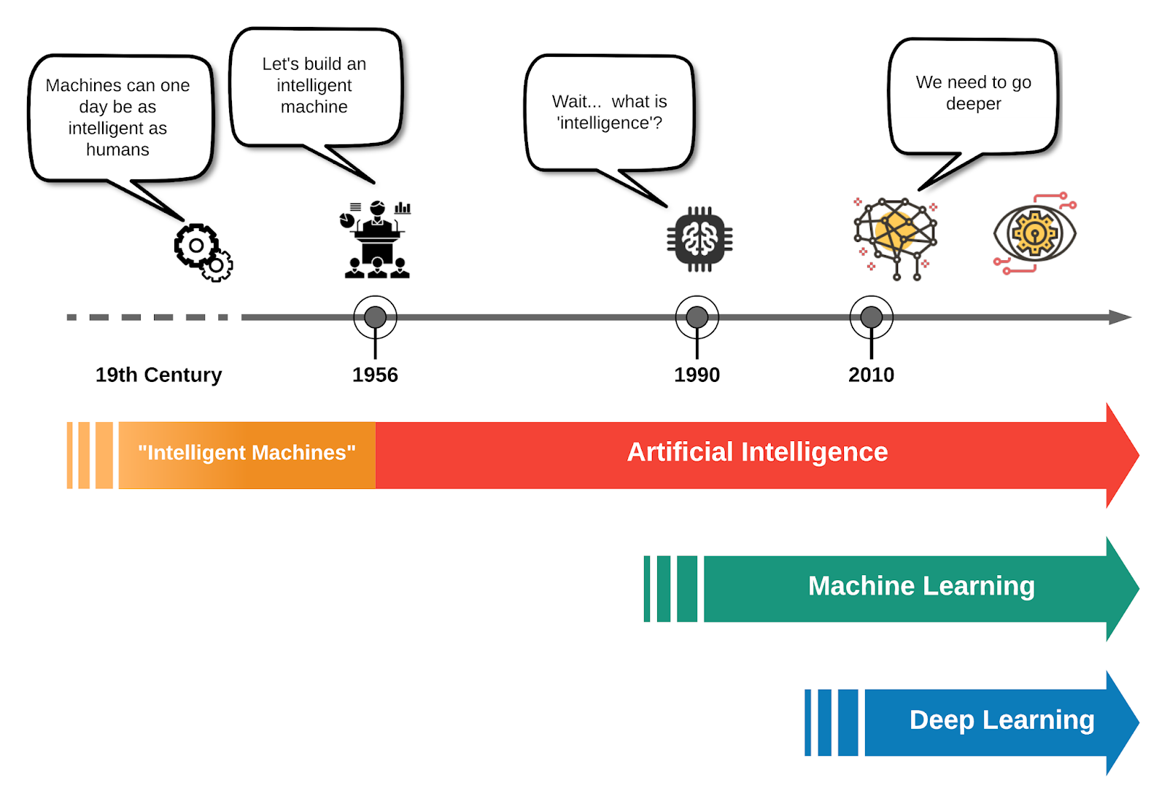
History

Slide 17
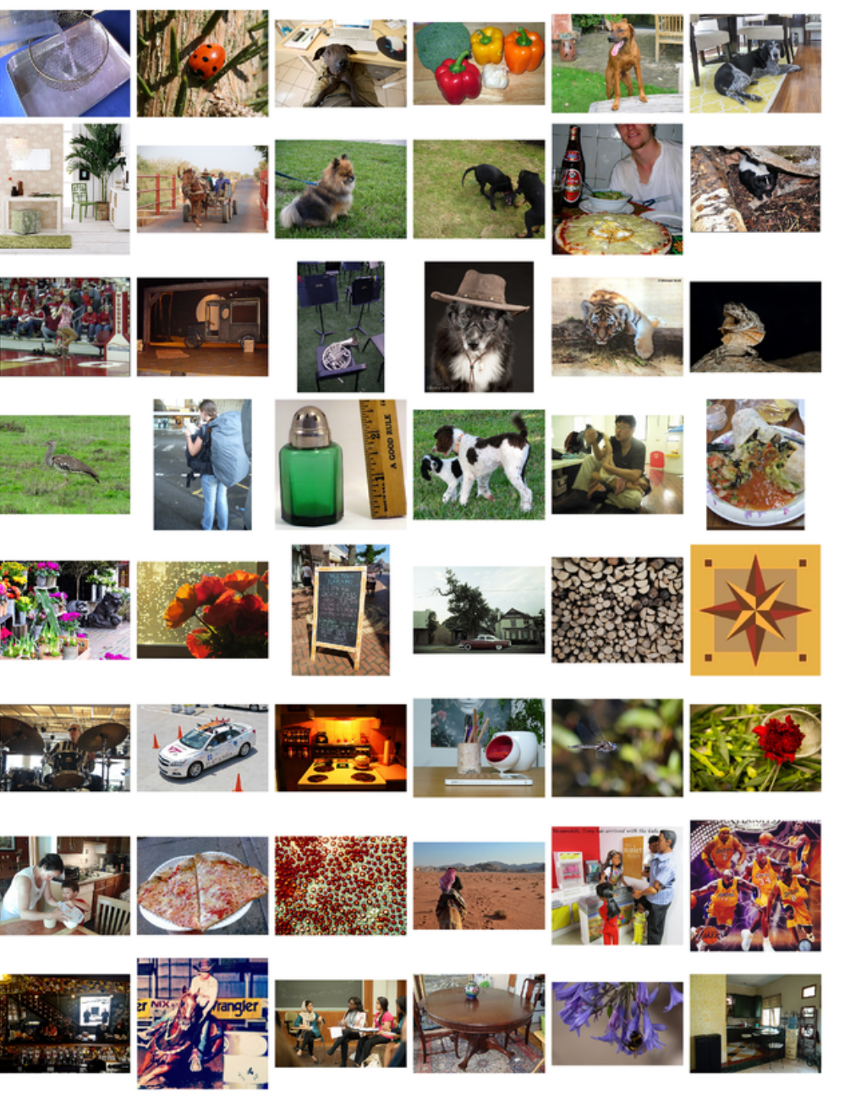
History
GPUs for fast computation (GPU for deep learning by Andrew Ng, 2009)
Effective neural network components E.g. dropout (Hinton, 2012) and ReLU (Bengio, 2011)
Large annotated datasets e.g. ImageNet, 2011

Slide 18
Neural networks: an intuition

Slide 19
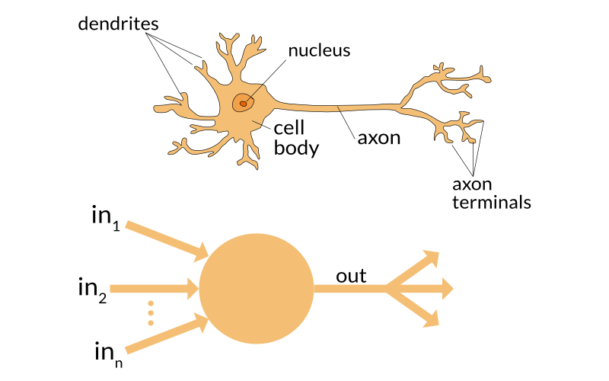
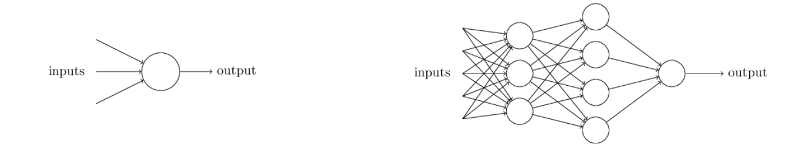
From neurons to nodes

Slide 20
From node to layer

Slide 21
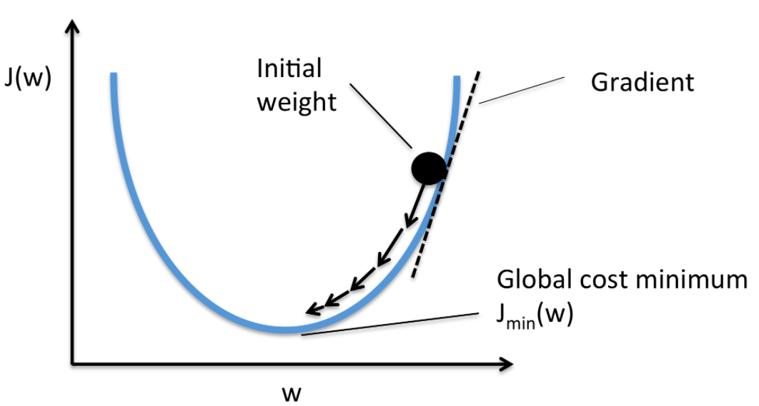
Training your network
Training
The process of tuning the weights w in a network by providing the network with example data - a combination of input data X and the target label the network should predict y

Slide 22
Practical example

Slide 23




How to create your neural network

Slide 24
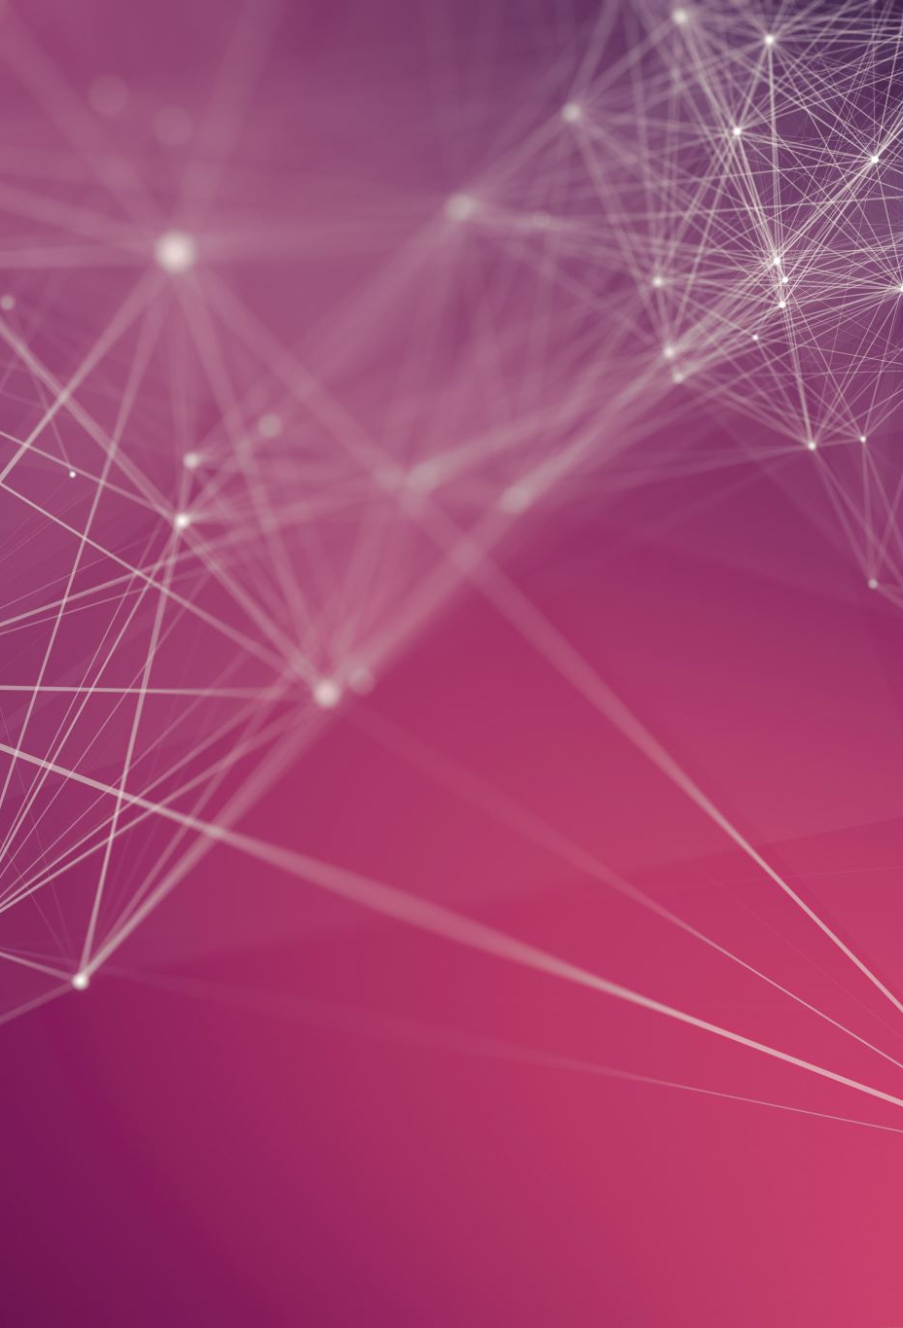
How to create your own DL model
Decide if you need deep learning
Ask yourself: do I have enough data?
Decide on the type of architecture for your problem:
Images, video: Convolutional Neural Network
Language: Recurrent Neural Networks
Create your network and experiment!

Slide 25
Questions?

